Slide 1
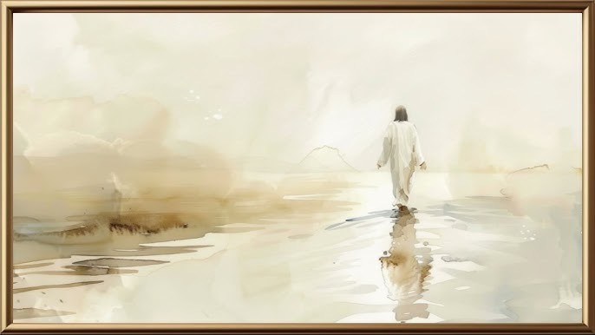
人子
The Son Of Man

Slide 2
你来过这里,走过这地 忍受饥饿 尝过眼泪的滋味. 你住在世间,三十三年 忍受背叛 走过死亡的刑场.
You’ve been here You walked through this land; You endured hunger You know the taste of tears; You lived in this world for thirty-three years; You endured the betrayal and were executed to death.

Slide 3
你竟这样表达你的爱,
创世的主宰 成为人的样式;
你竟这样表达你的爱,
挂在十架 为罪人受害.
You express Your love this way, The master of creation took the appearance of a man. You express Your love this way, You were hung on the cross for all sinners.

Slide 4
你来过这里,走过这地 忍受饥饿 尝过眼泪的滋味. 你住在世间,三十三年 忍受背叛 走过死亡的刑场.
You’ve been here You walked through this land; You endured hunger You know the taste of tears; You lived in this world for thirty-three years; You endured the betrayal and were executed to death.

Slide 5
你竟这样表达你的爱,
赦免人过犯 赏赐真平安;
你竟这样表达你的爱,
受苦的主 荣耀的君王.
You express Your love this way, You forgive our sin and reward us true peace. You express Your love this way, The suffering Lord, the King of glory.

Slide 6
啊! 啊！
你竟这样表达你的爱，
复活的主 荣耀的君王！
You express Your love this way; The Risen Lord, the King of glory!

Slide 7
你竟这样表达你的爱,
创世的主宰 成为人的样式;
你竟这样表达你的爱,
挂在十架 为罪人受害.
You express Your love this way, The master of creation took the appearance of a man. You express Your love this way, You were hung on the cross for all sinners.

Slide 8
你竟这样表达你的爱,
赦免人过犯 赏赐真平安;
你竟这样表达你的爱,
复活的主 荣耀的君王.
You express Your love this way, You forgive our sin and reward us true peace. You express Your love this way, The suffering Lord, the King of glory.

Slide 9
啊! 啊！
你竟这样表达你的爱，
复活的主 荣耀的君王！
You express Your love this way; The Risen Lord, the King of glory!

